Slide 1
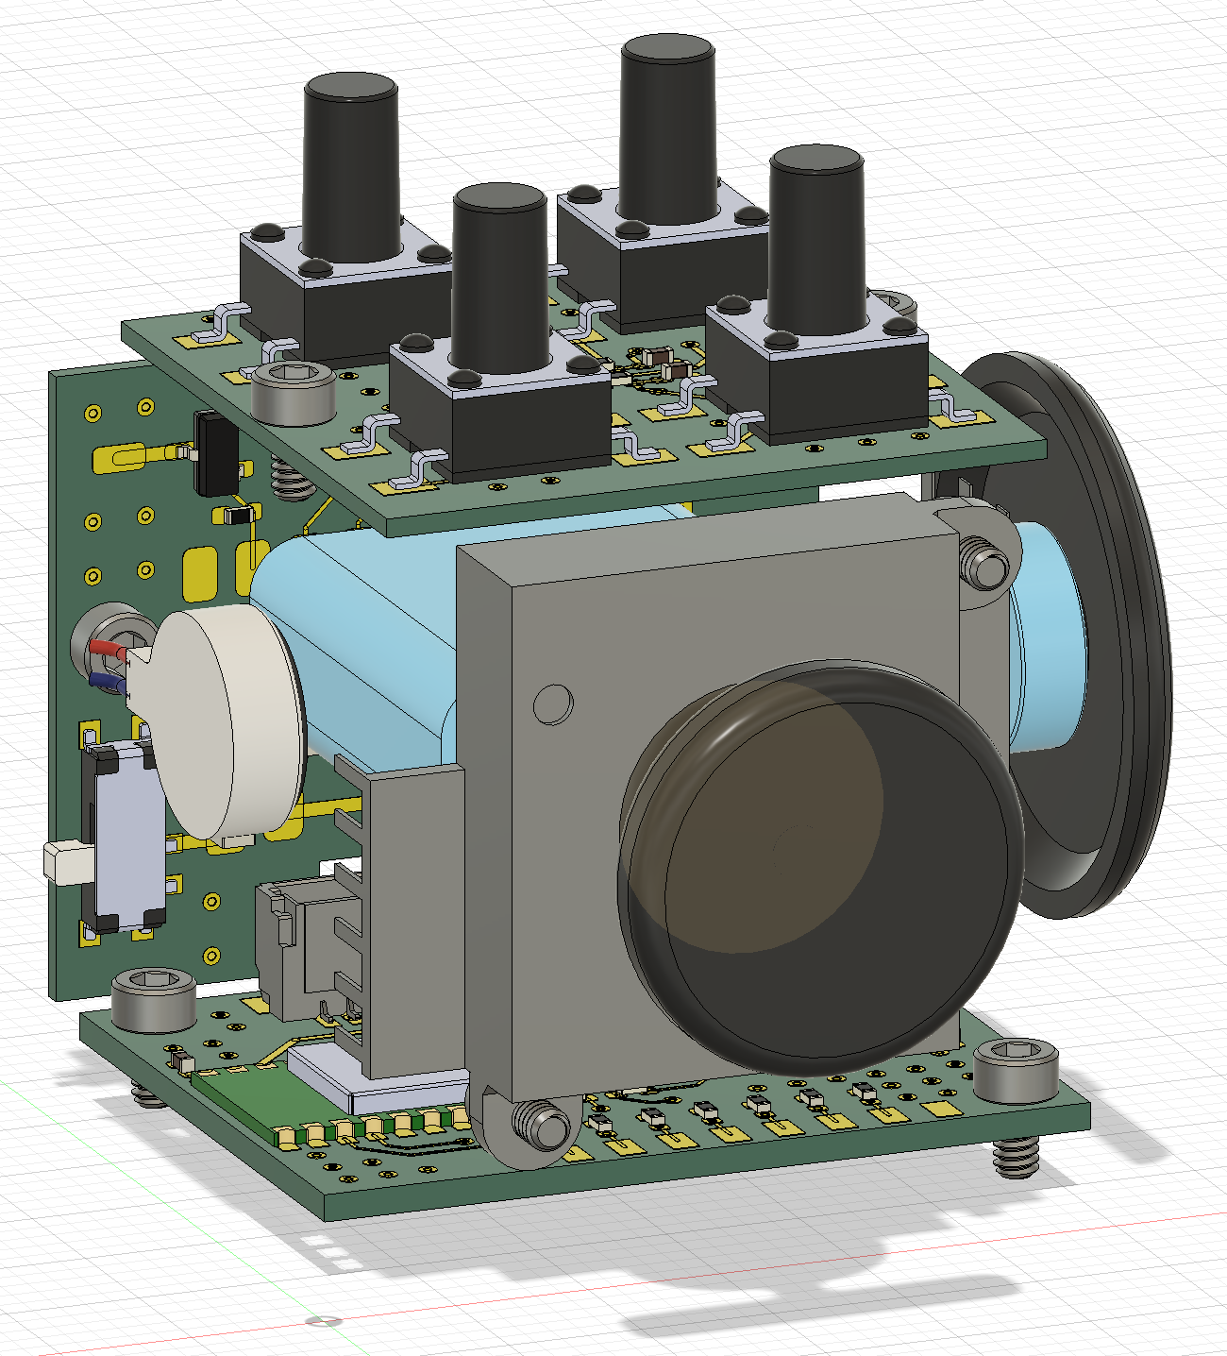
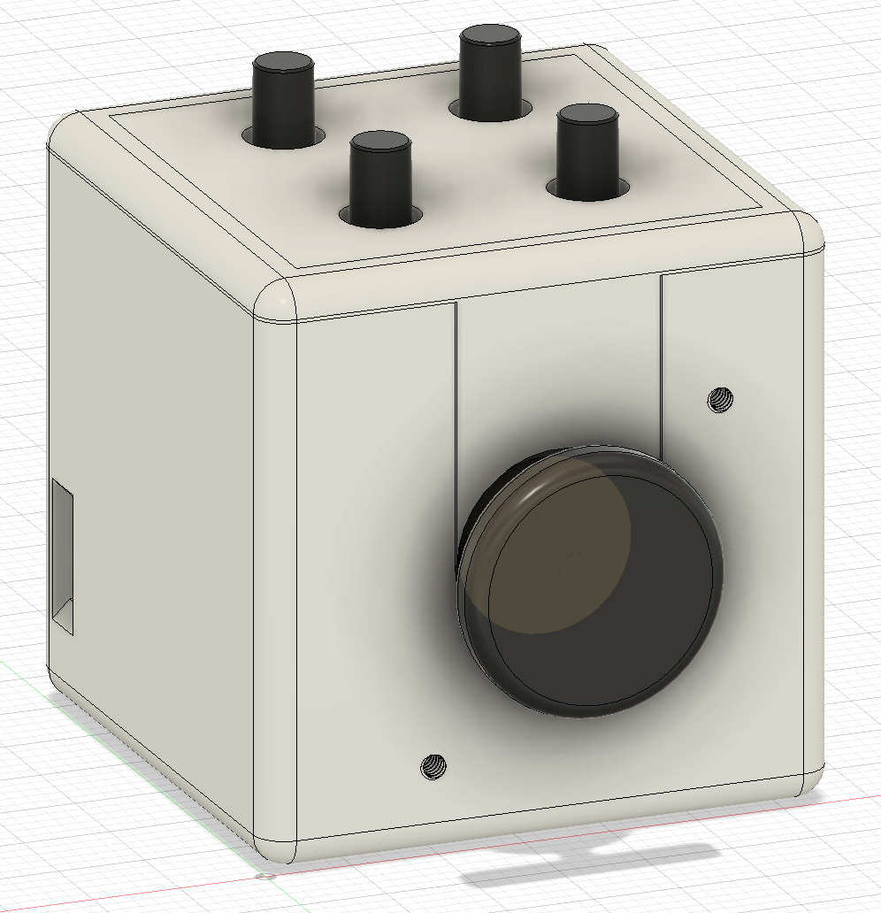
Button board
Connector board
Ball bearing
100mAh Li-Po
TTC encoder
Linear vibration motor
Joystick
33mm
Main control board
33mm
33mm

Slide 2
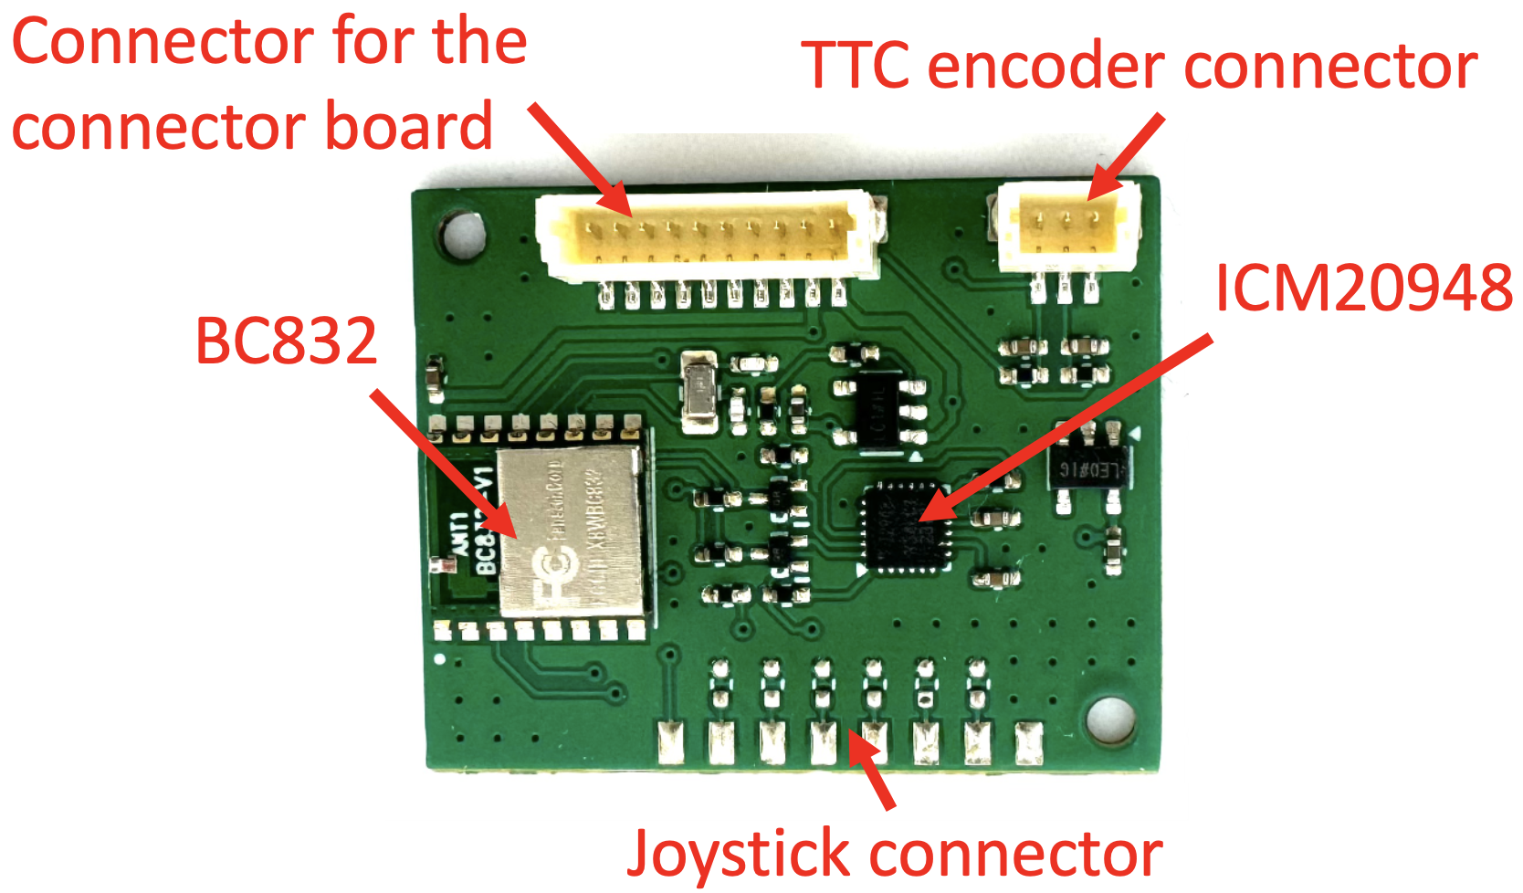
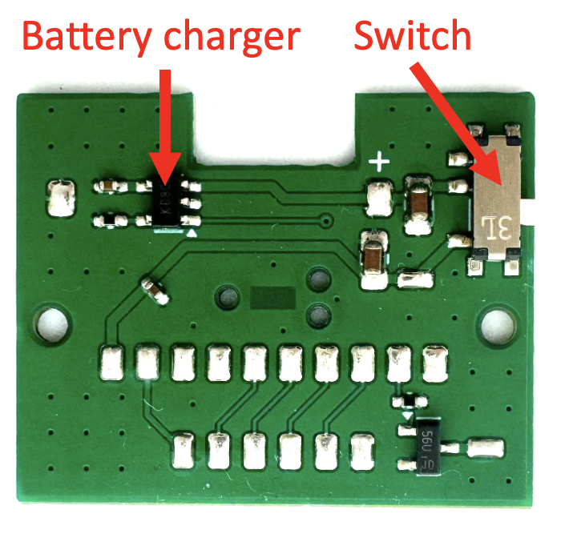
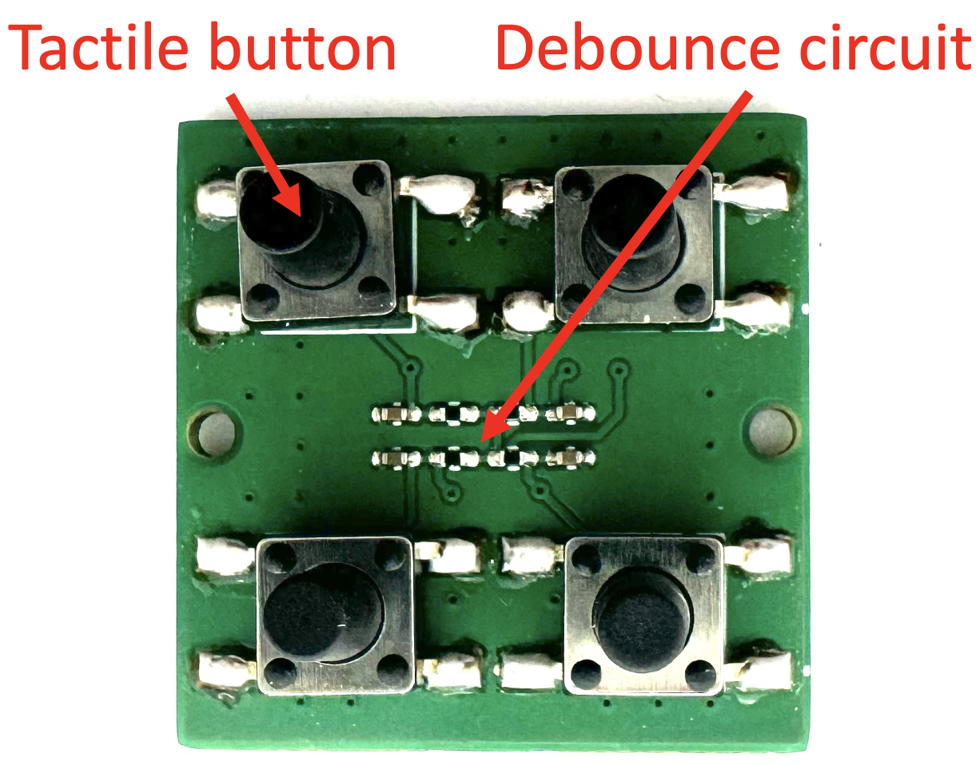
Main control board
Button board
Connector board

Slide 3
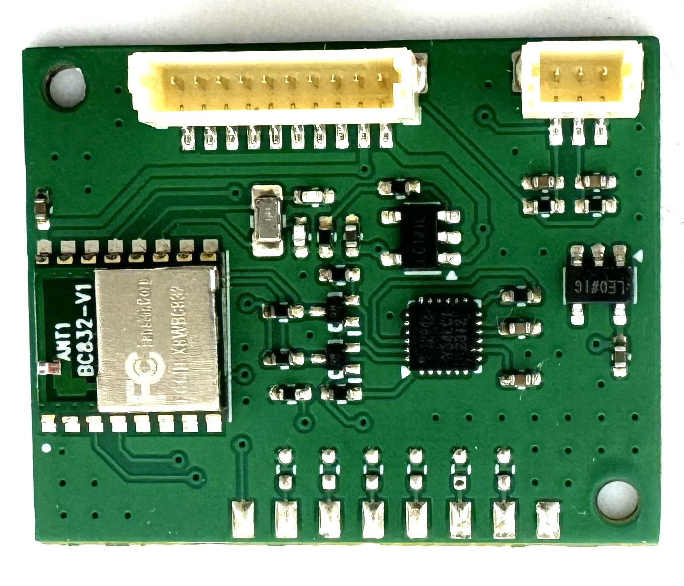
Connector for the connector board
TTC encoder connector
ICM20948
BC832
Joystick connector

Slide 4
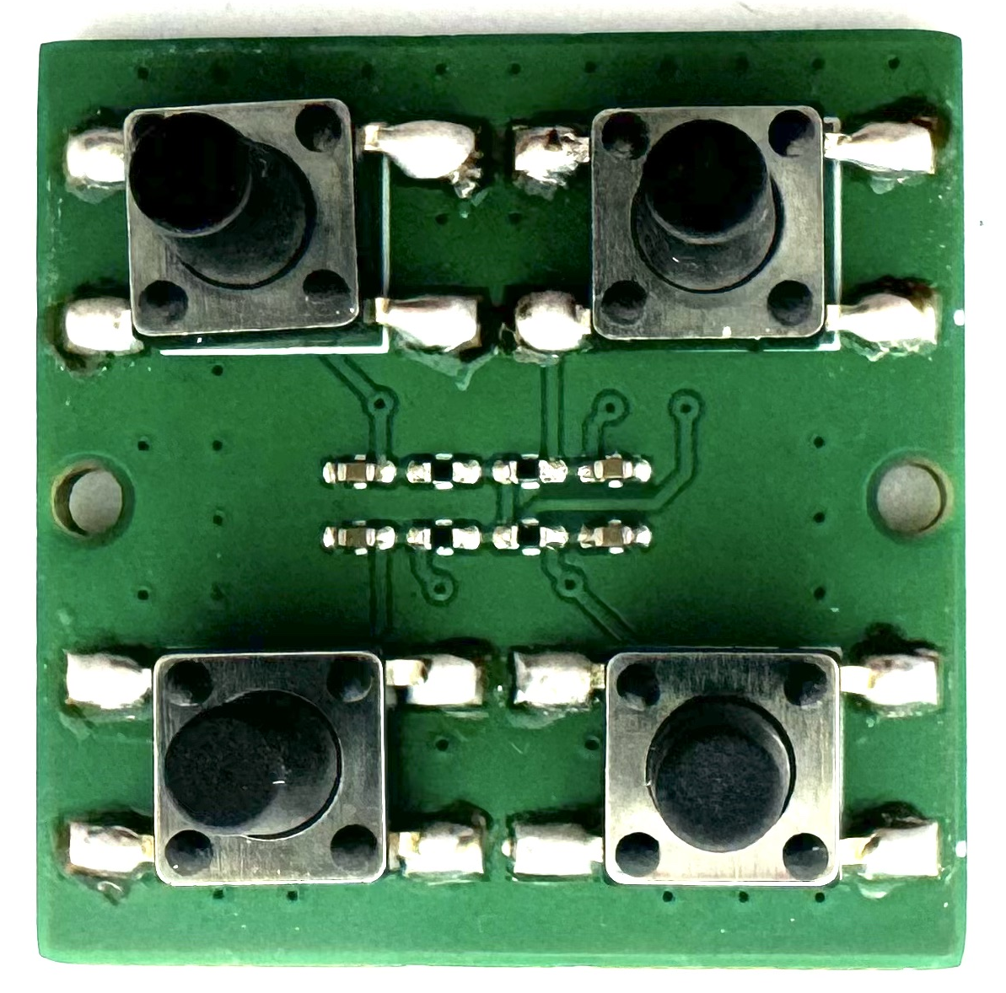
Tactile button
Debounce circuit

Slide 5
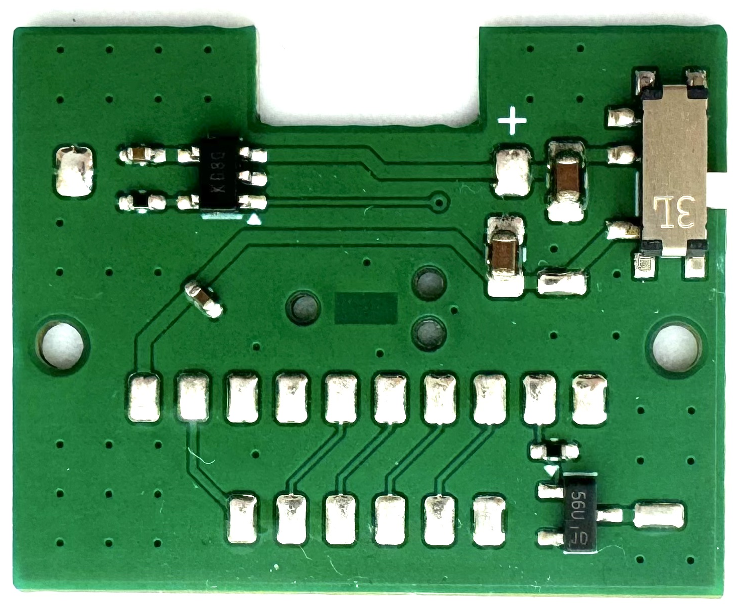
Battery charger
Switch

Slide 6
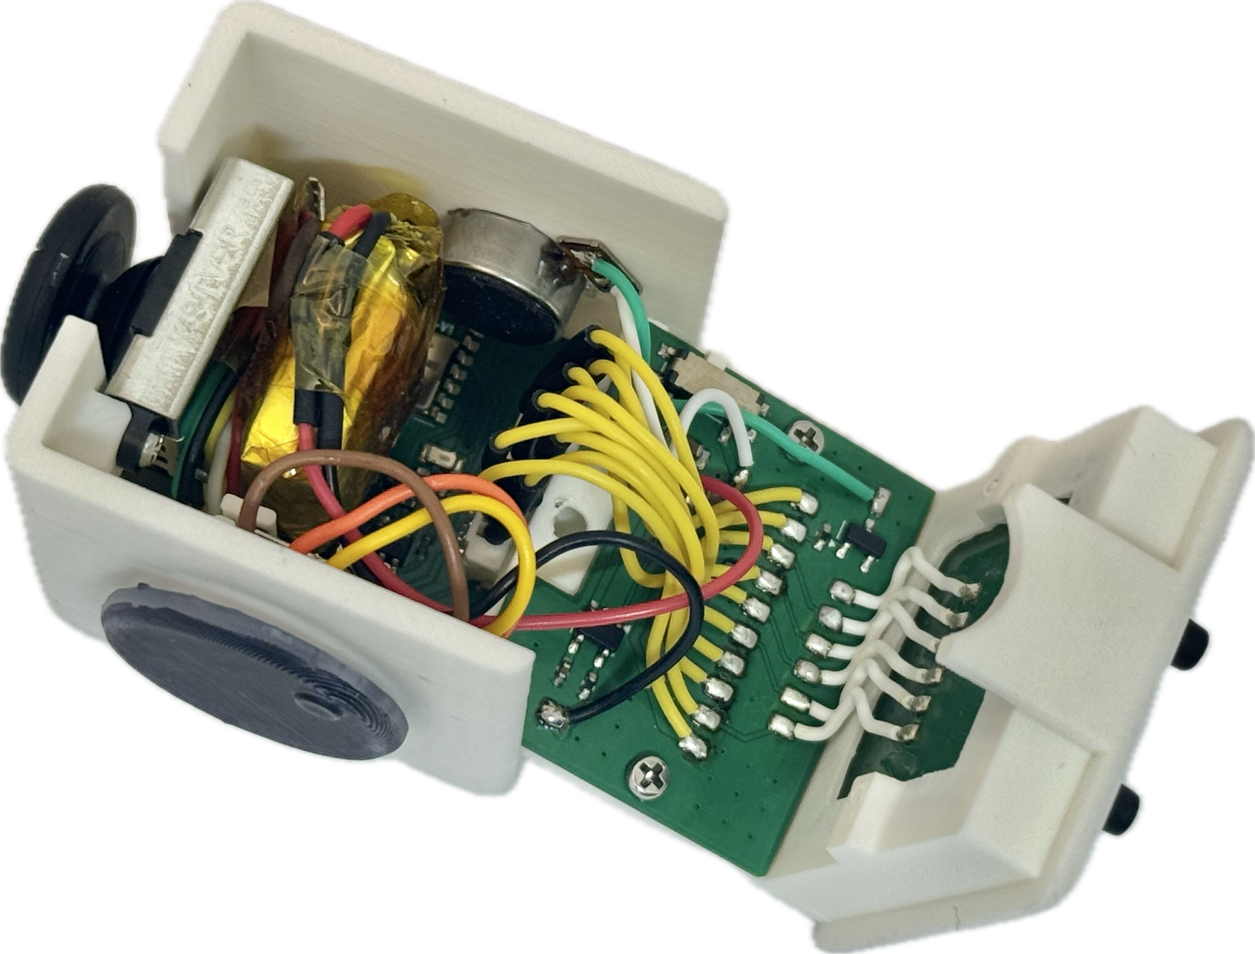
Main control board
Linear vibration motor
Joystick
Connector board
Button board
100mAh LiPo
TTC encoder

Slide 7
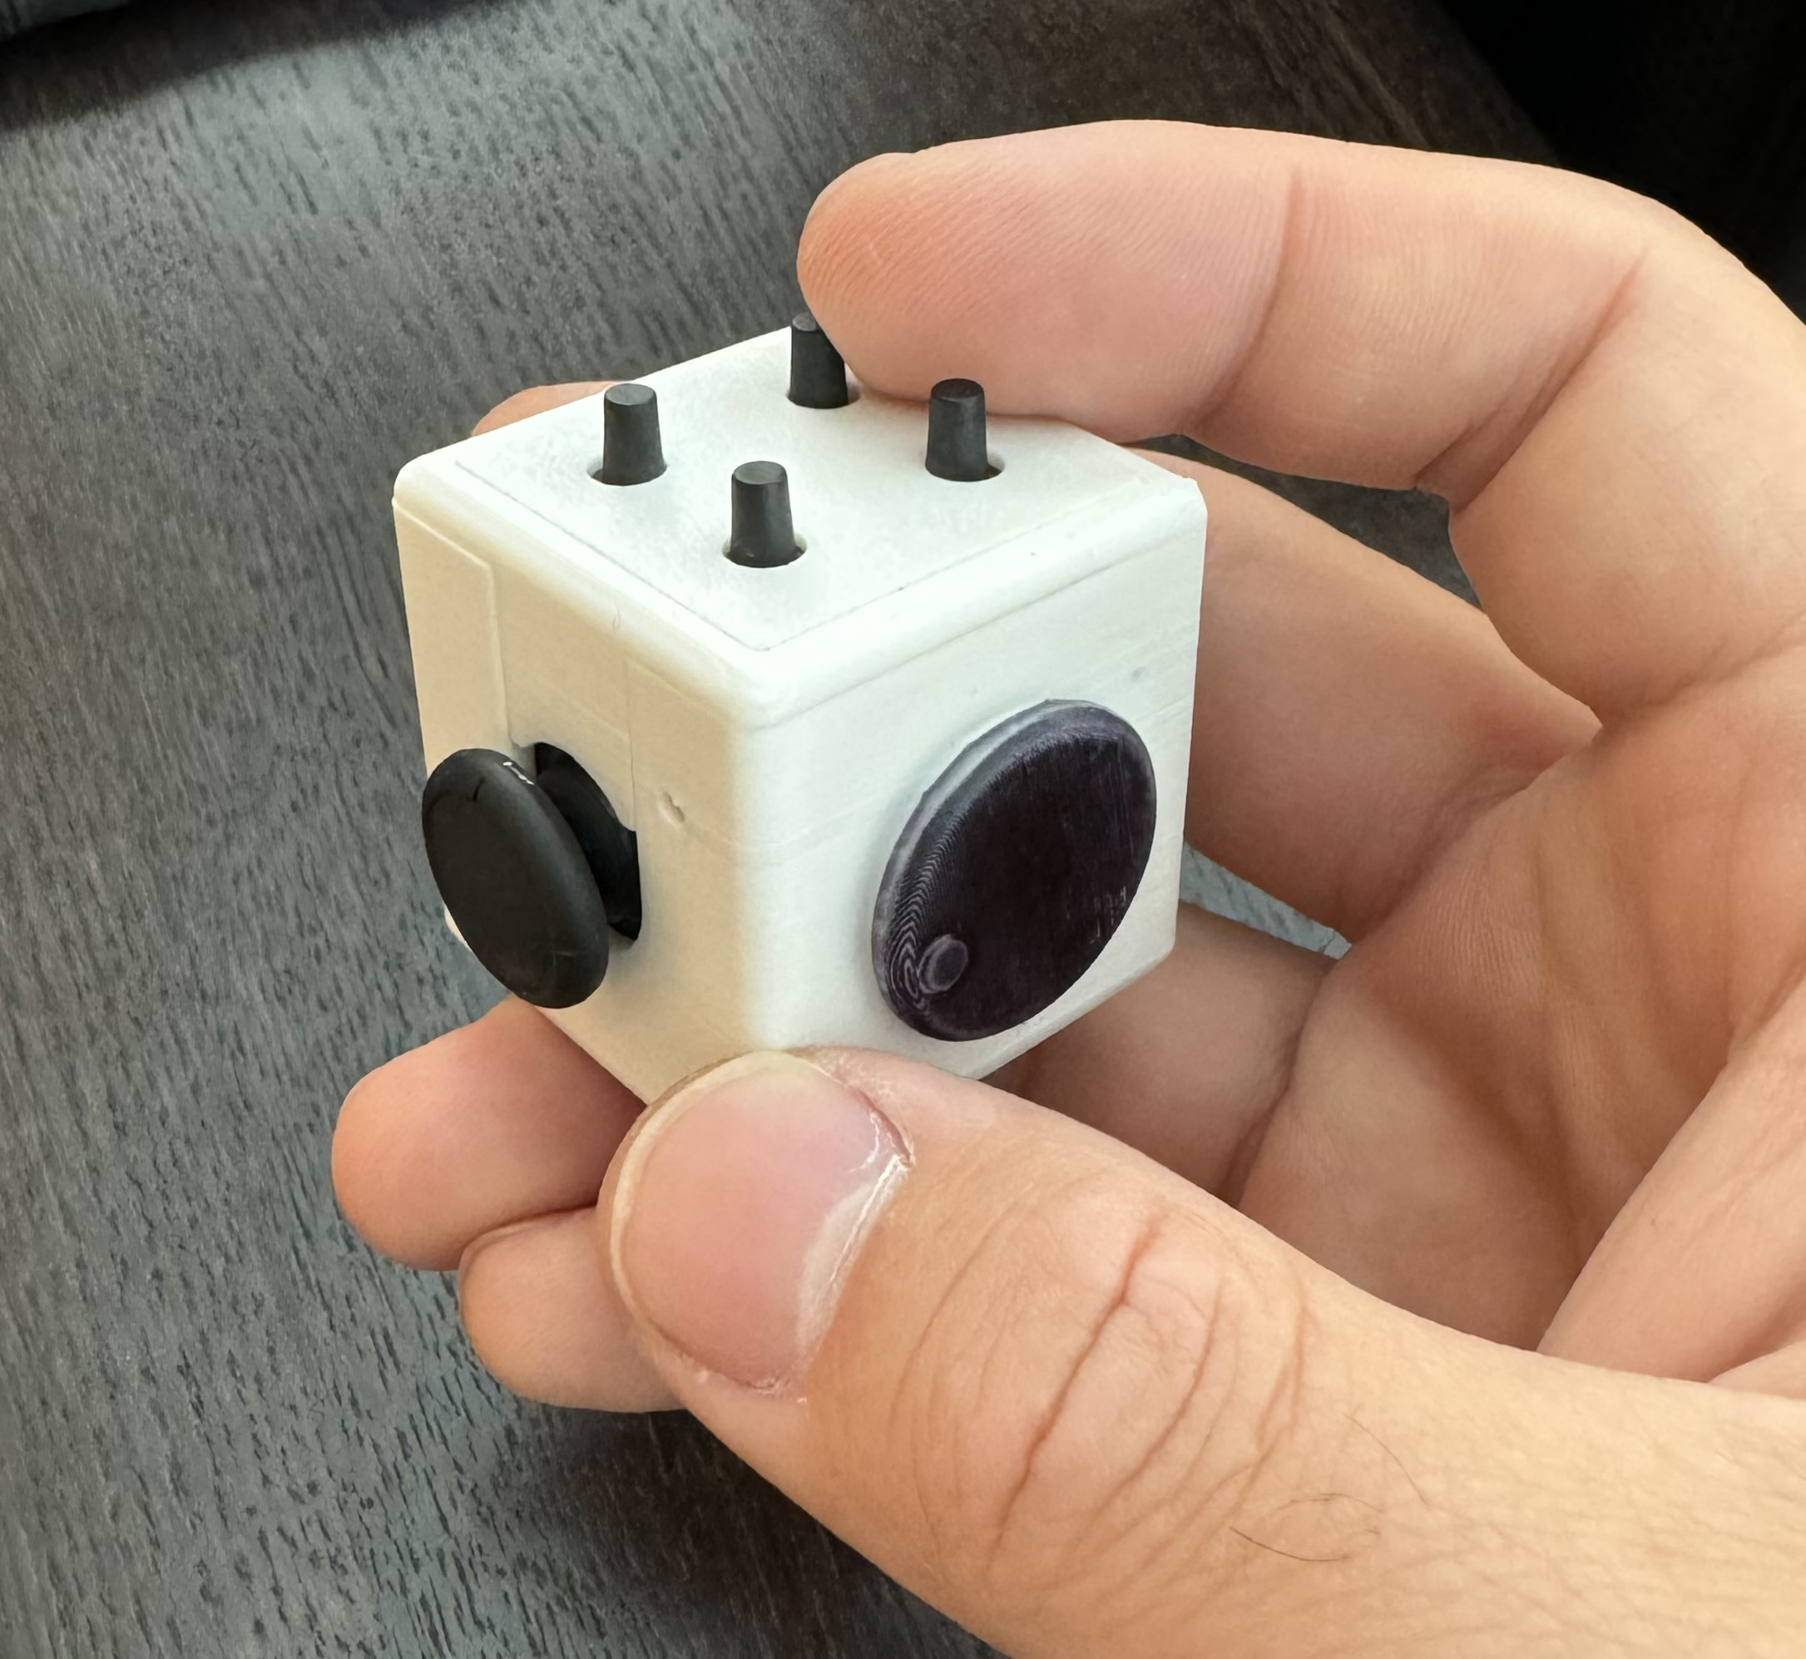
33mm
33mm
33mm

Slide 8
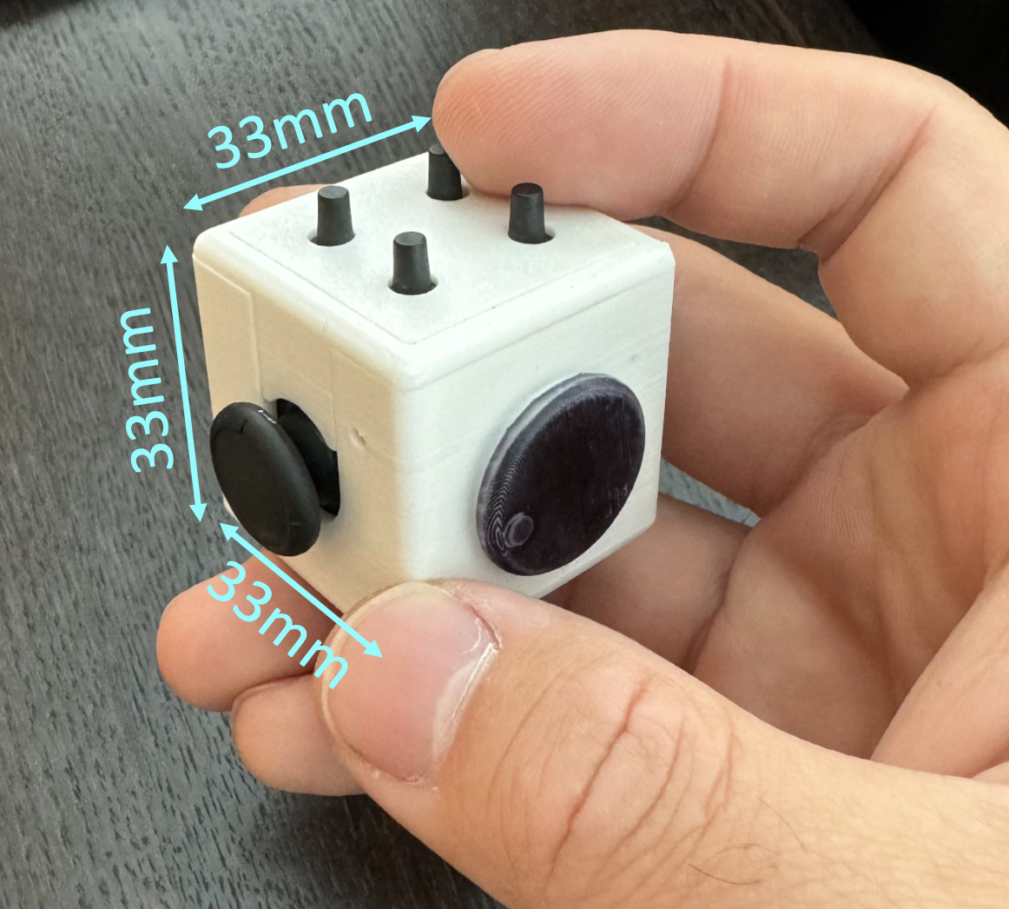
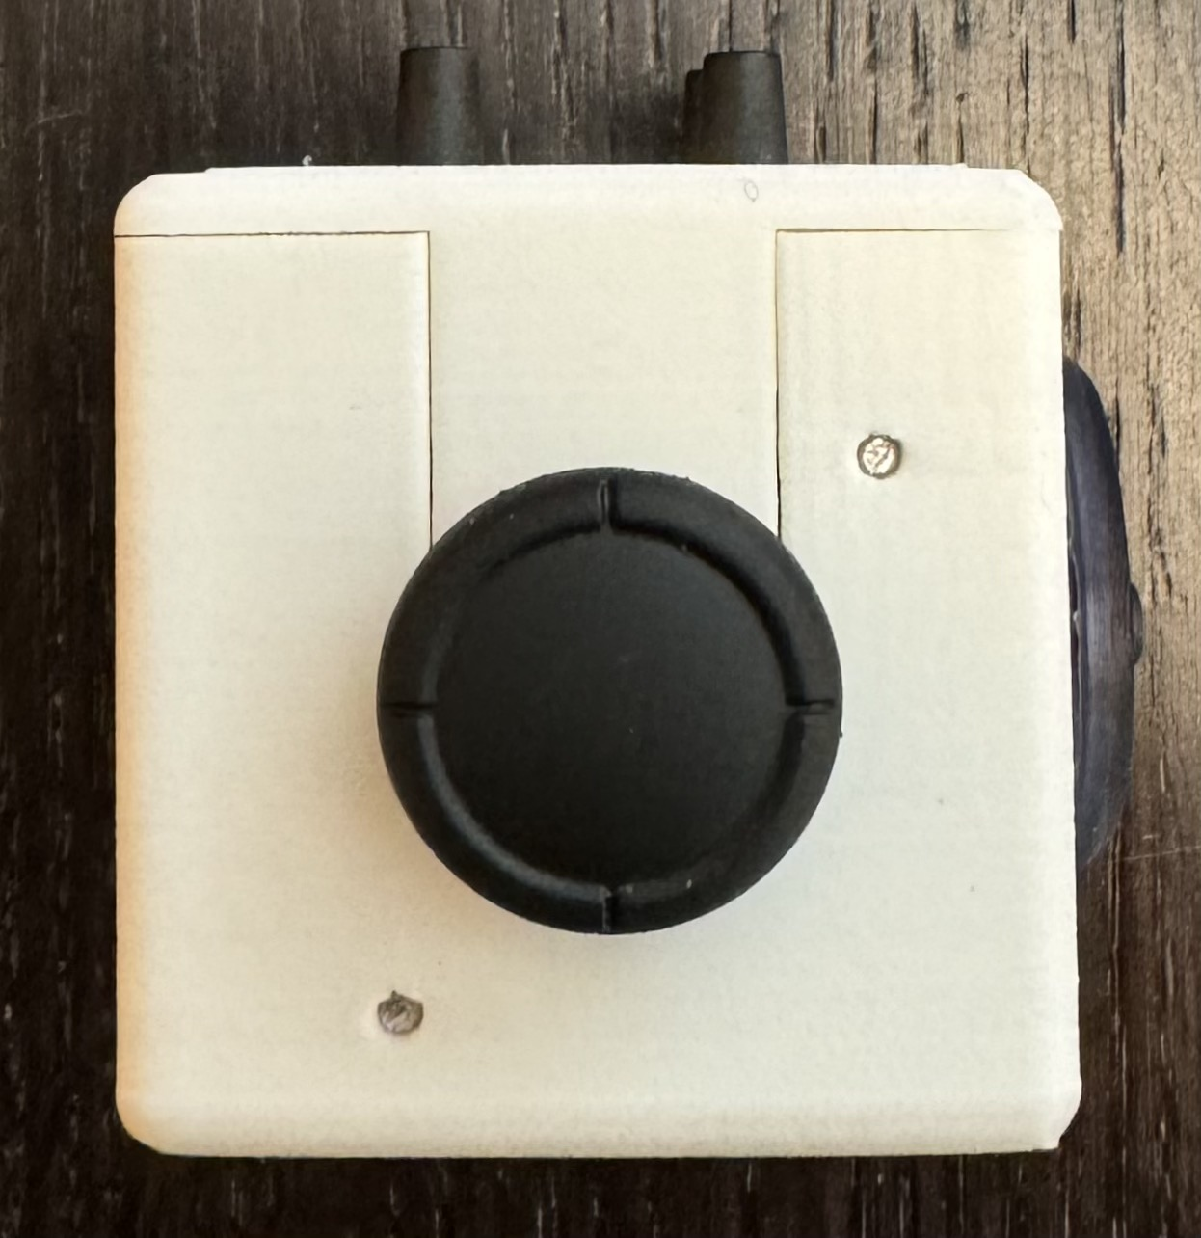
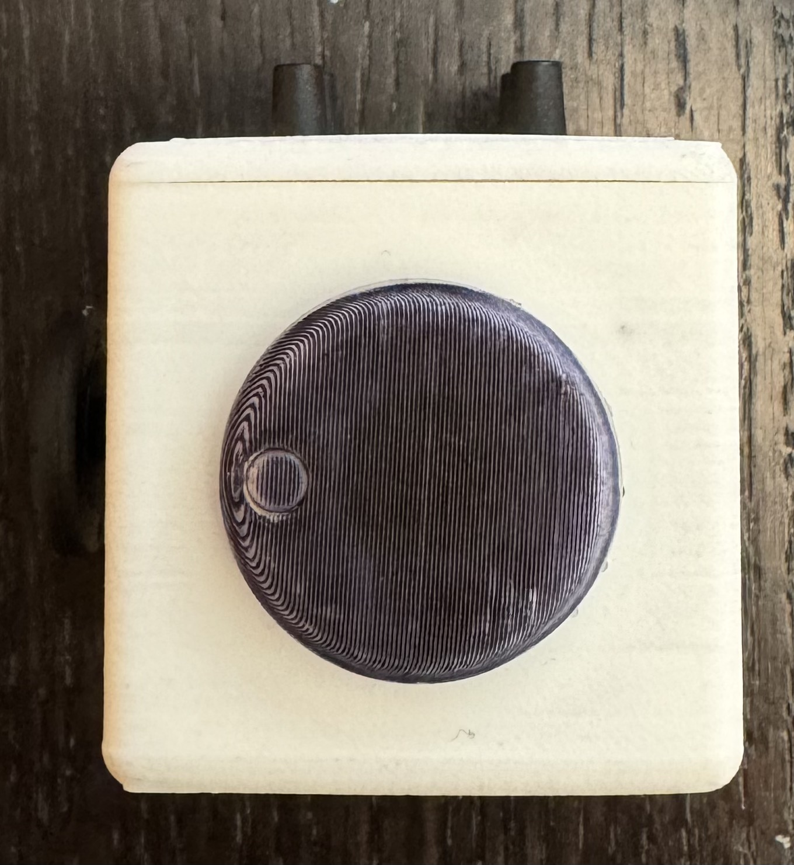
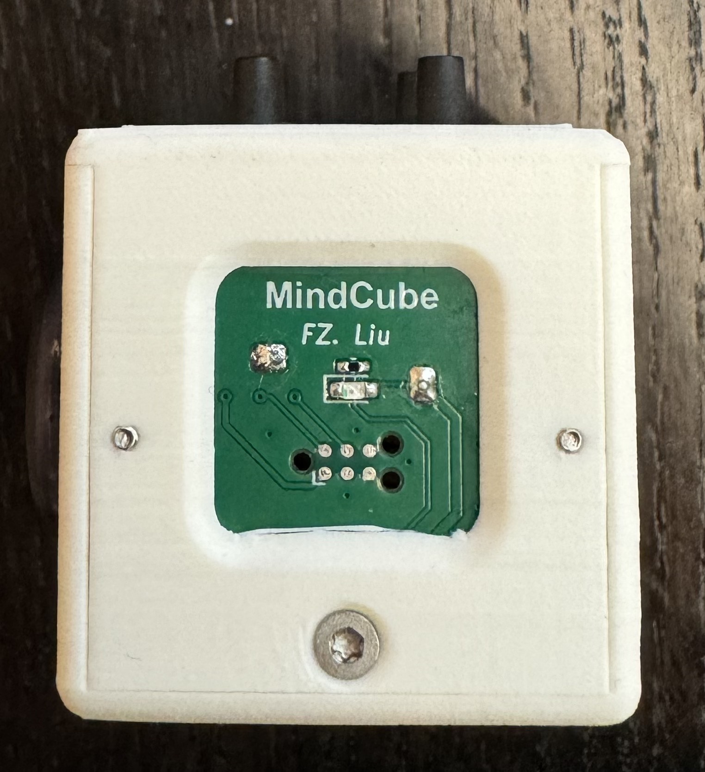
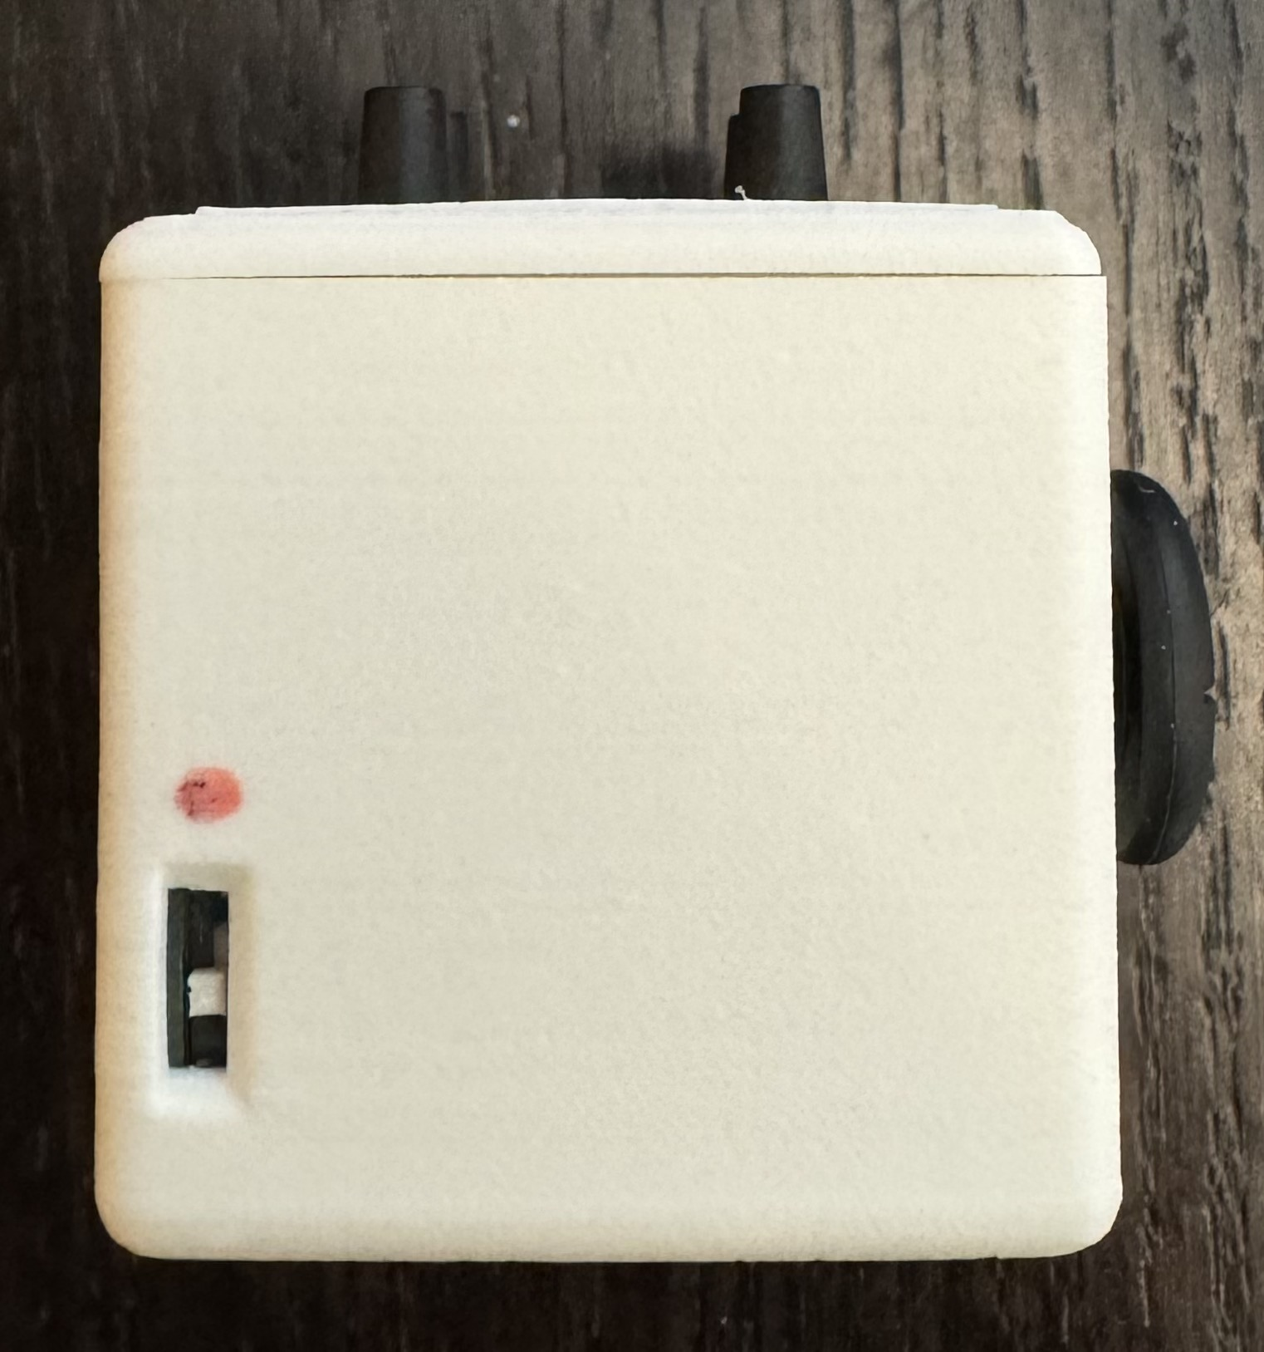
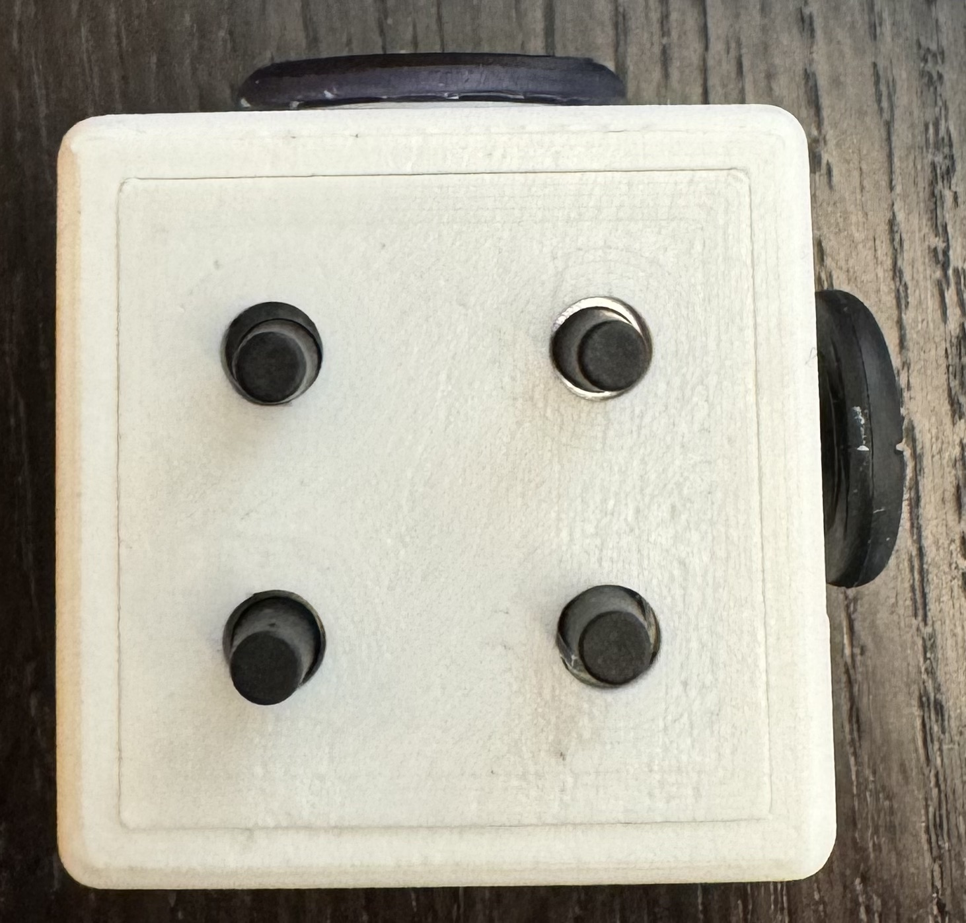
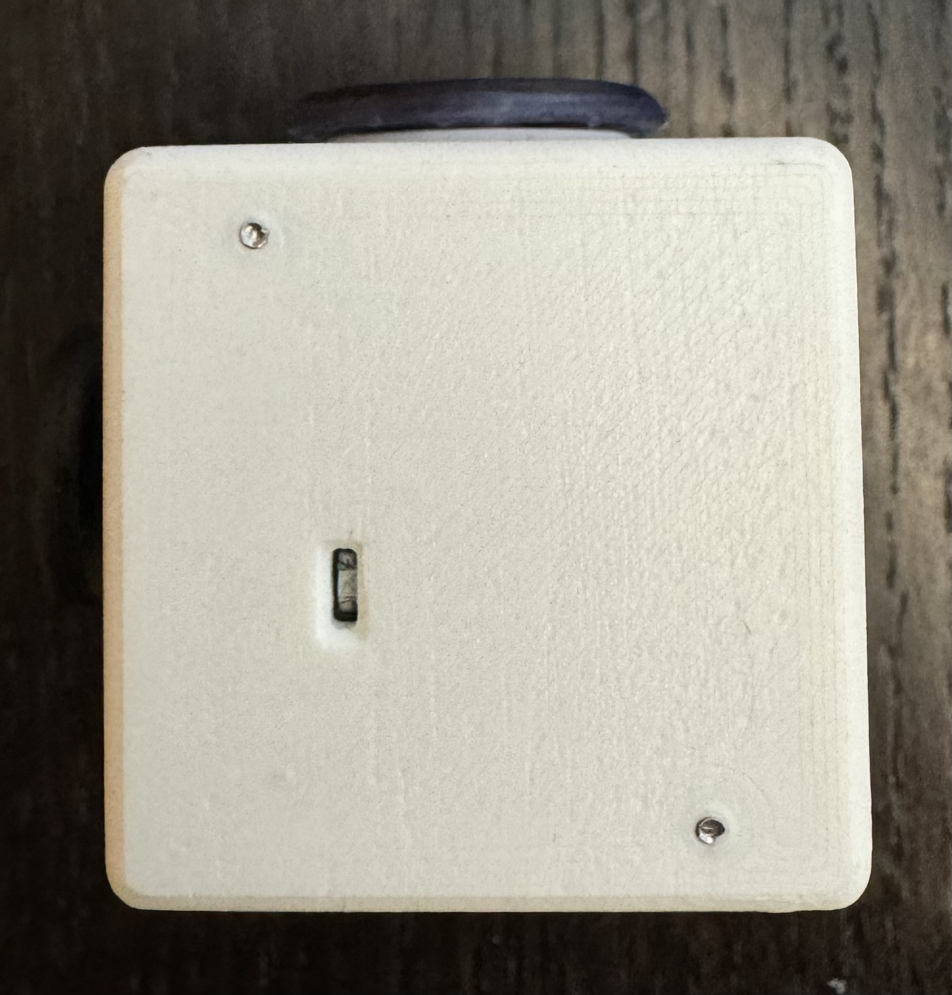
b
c
d
a
e
f
g

Slide 9
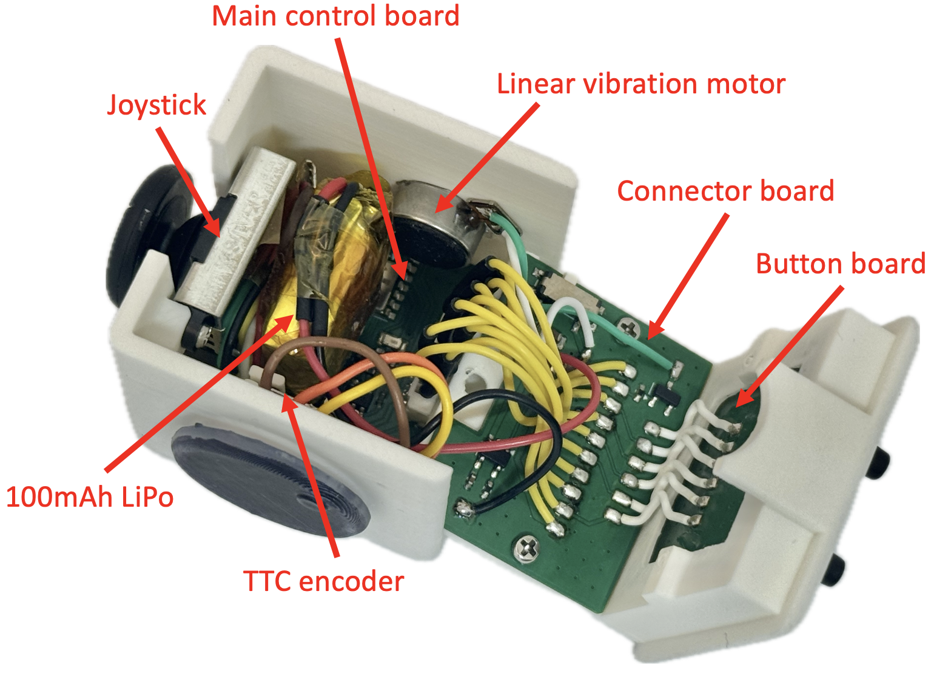
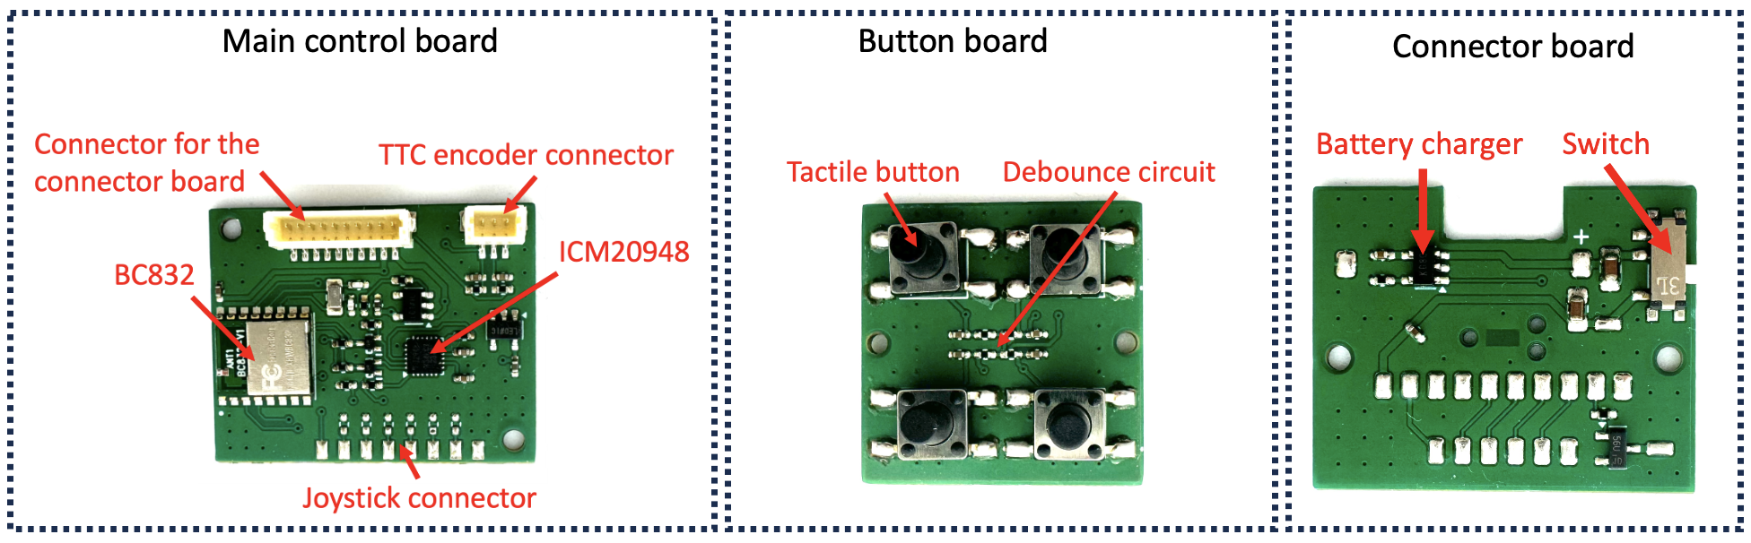

Slide 10
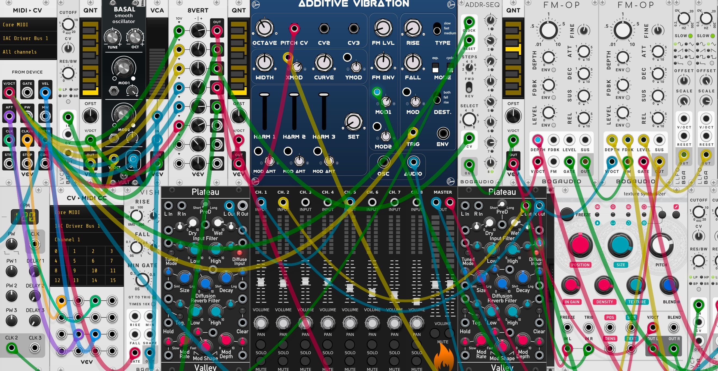
Mapping
MIDI
Music

Slide 11
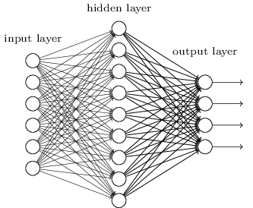
Neural Network
Focused?
Sensors data
Distracted?
Stressed?
Calm?
…
Haptic feedback

Slide 12
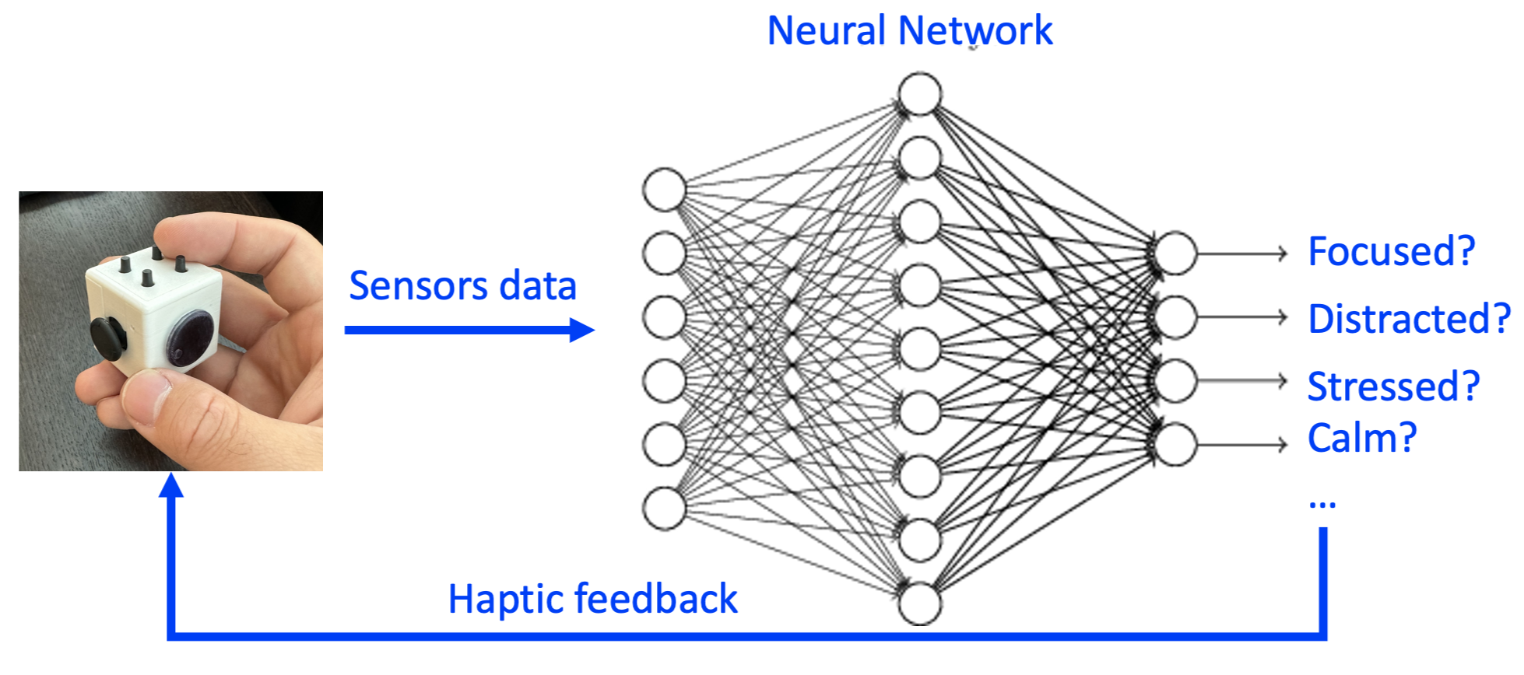
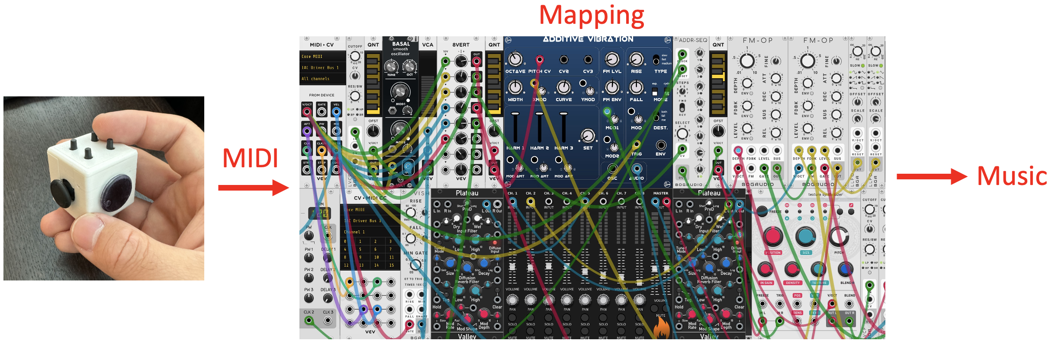
a
b

Slide 13
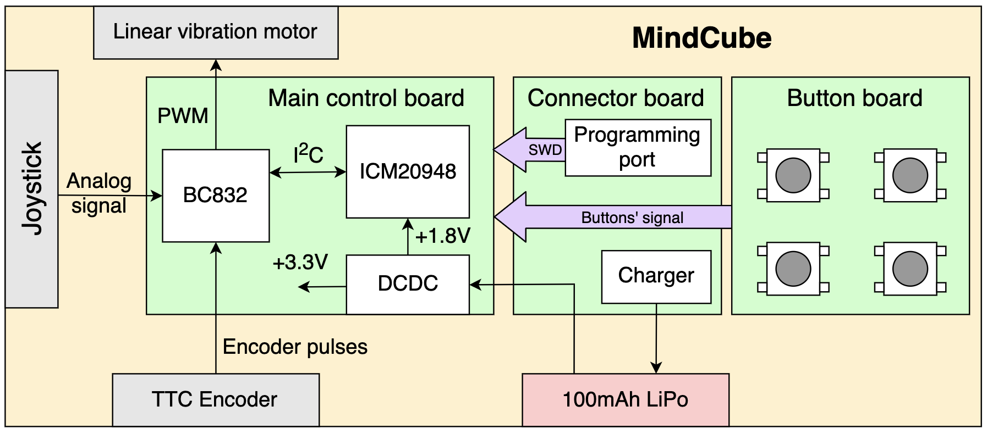

Slide 14
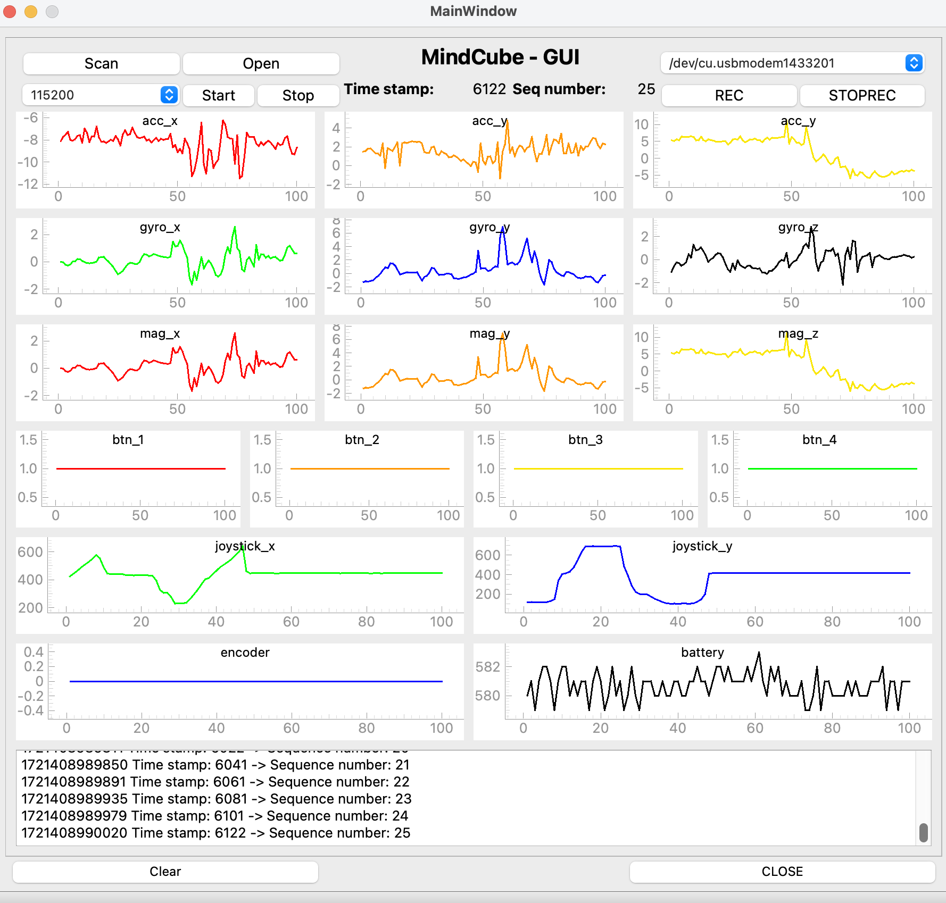

Slide 15
a
b

Slide 16
- size of the booth: 1.5m x 1 m - demo hardware components: MindCube - numbers of tables: 1 - chairs: 1 - light or dark environment required: light environment required - power requirements: one outlet - VR setup: no - poster stand (recommended): yes - any other equipment or relevant detail: no
1.5m
booth
0.5 m
1 m
table
0.5 m

